Slide 1
2019 National Ag Day
Program Recap

Slide 2
Agriculture: Food for Life National Grassroots Campaign Culminates in Washington, DC for a national day of observance.
Comprehensive planning kit for grassroots events
Educational resources
Student Hill Visits
Ag Day Declaration Event
Taste of Ag Celebration
Ag Day Essay Competition

Slide 3
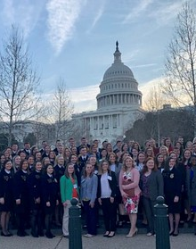
Student Hill Visits
Approximately 100 student representatives from FFA, AFA, 4-H and MANNRS traveled to DC to meet with congressional representatives and deliver the message of Ag Day. The group met at the 4-H center for message training, followed by a morning of Hill visits.

Slide 4
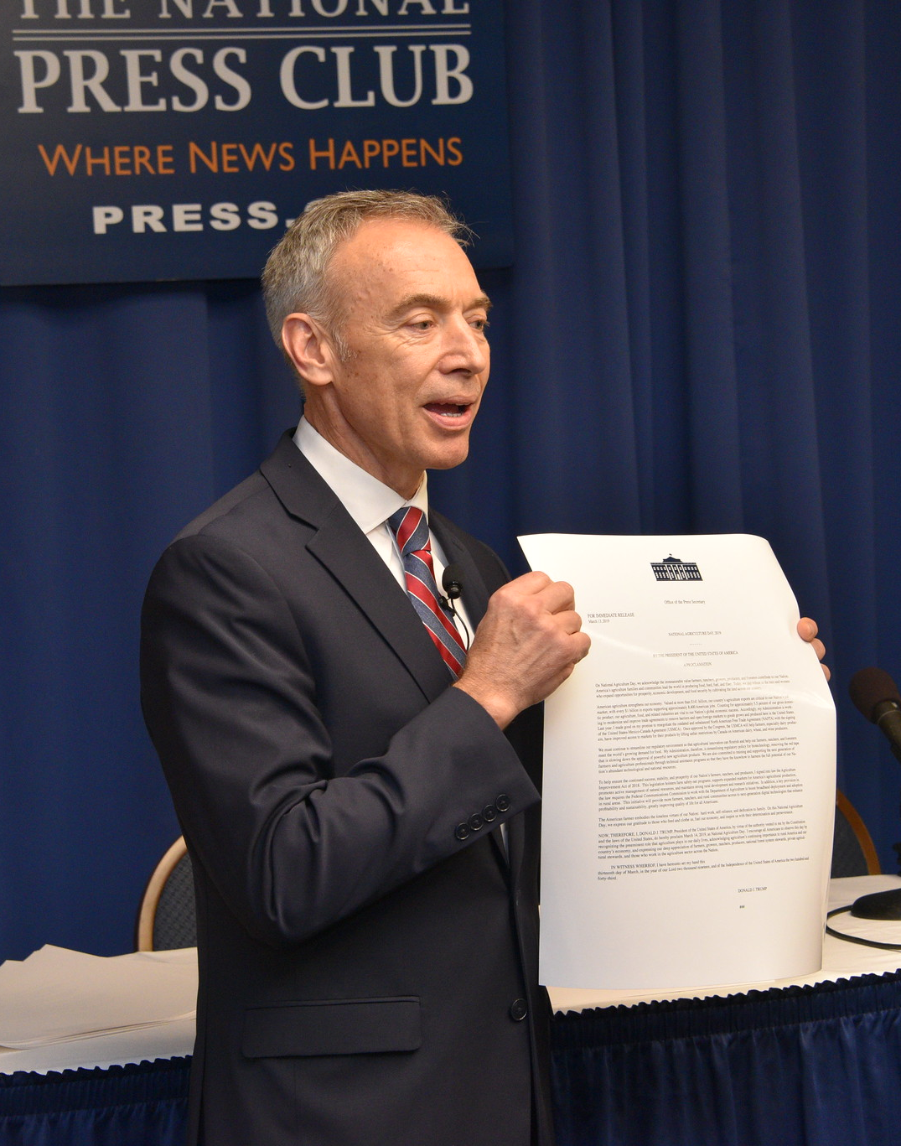
Press Club Event
Ag Day in DC featured an afternoon at the National Press Club where United States Deputy Secretary of Agriculture Stephen Censky kicked off the afternoon with remarks detailing USDA’s launch of their new Youth and Agriculture Web Site. He delivered the signed Presidential proclamation.
The event also featured a panel of high school and college students.

Slide 5
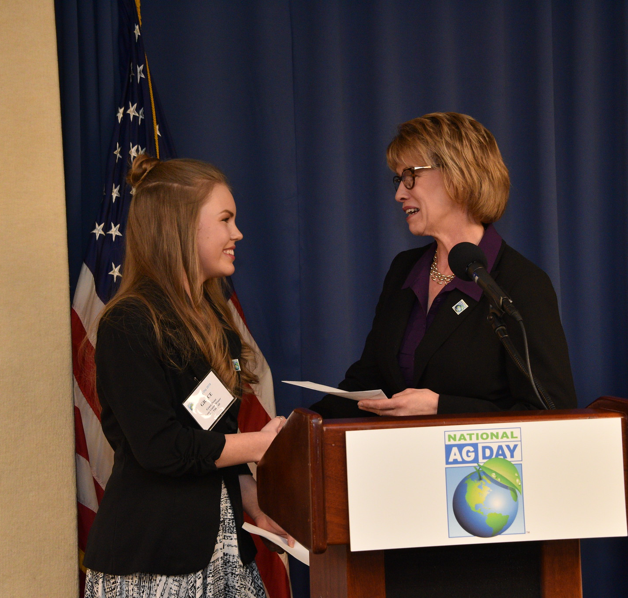
Essay Contest
The winner of the Ag Day Essay Contest was presented with a $1000 scholarship during the Press Club Event. Grace Brose from Box Elder, South Dakota, won the written essay contest.
Jacob Kandell from Mason, Ohio, was honored as the 2019 National Video Essay winner.

Slide 6
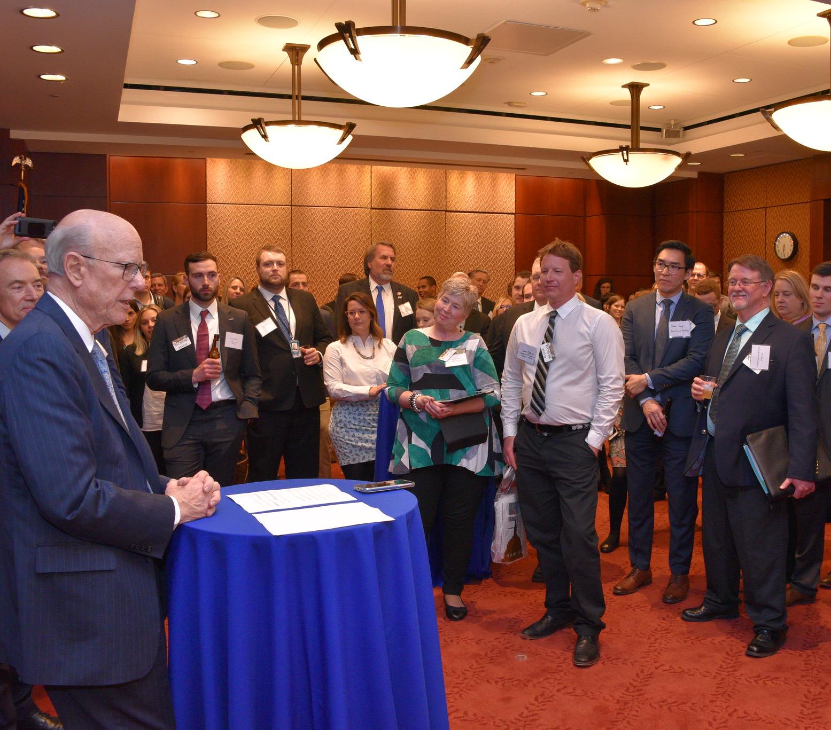
Celebration of American Agriculture
The Celebration of American Agriculture took place at the Capitol Visitor Center. The reception was attended by approximately 200 congressional staff members and industry representatives.

Slide 7
A Groundswell of Support
3,700+ news articles appeared in publications across the nation
Nearly 3 million estimated readership of print outlets highlighting National Ag Day

Slide 8
Top Market Coverage
7.3+ million – value of print placement coverage
1,668 number of news placements from the top 50 markets
45% of media placements were in the top 50 markets
Nearly 2/3 in the top 100

Slide 9
Social Media
Facebook impressions surge in the months leading up to Ag Day.
Twitter impressions also surge in the months leading up to March.

Slide 10
Ag Day is made possible by the generous contributions of organizations, foundations and businesses. Thank you to our 2019 sponsors.

Slide 11
National Ag Day 2020 March 24
Theme for 2020: Food Brings Everyone to the Table

